Slide 1
Jane Austen’s Sense & Sensibility
Roberta Grandi – Università della Valle d’Aosta

Slide 2
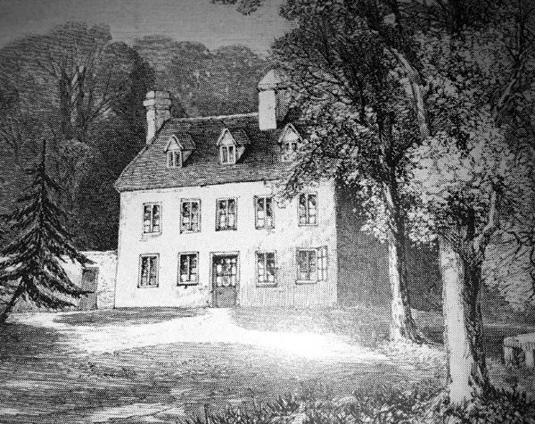
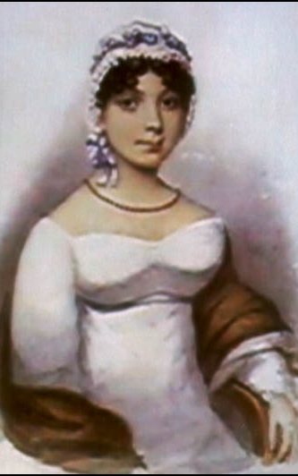
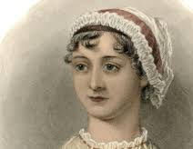
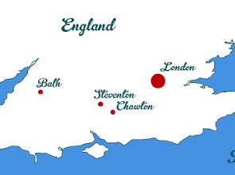
Jane Austen’s biography
Born on 16th December 1775, in Steventon, Hampshire
Her father: the Reverend George Austen – a clergyman and teacher of a boarding school for boys
8 children (6 boys, 2 girls)
When Jane died, her elder sister, Cassandra, burned most of their correspondence
Education
When she was 7 she was sent with Cassandra to a boarding school in Oxford but returned home soon because of a typhus epidemics.
Boarding school in Reading till the age of 10
At home, extensive use of their rich library.

Slide 3
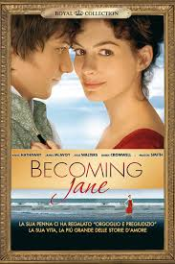
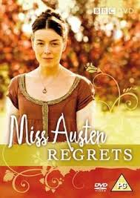
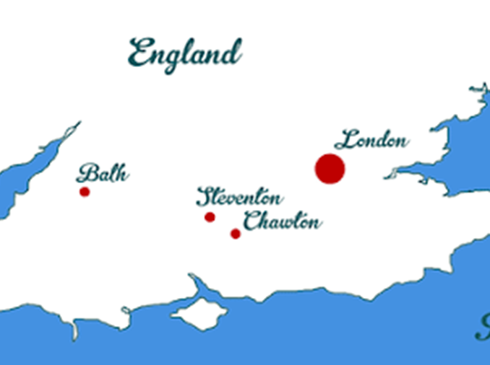
Jane Austen’s life
Love life – “Becoming Jane” “Jane Austen’s Regrets”
1795-96 Tom Lefroy
1802 (age of 26) receives a marriage proposal by Harry Bigg-Wither
Doctor, Charles Thomas Haden, 1815
In 1800 the family moves to Bath
The father dies in 1805
In 1808 they move to Chawton

Slide 4
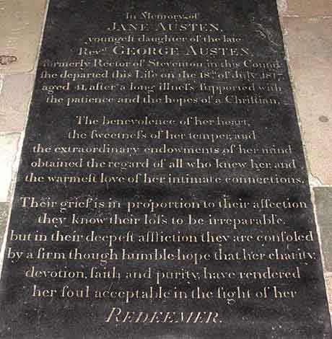
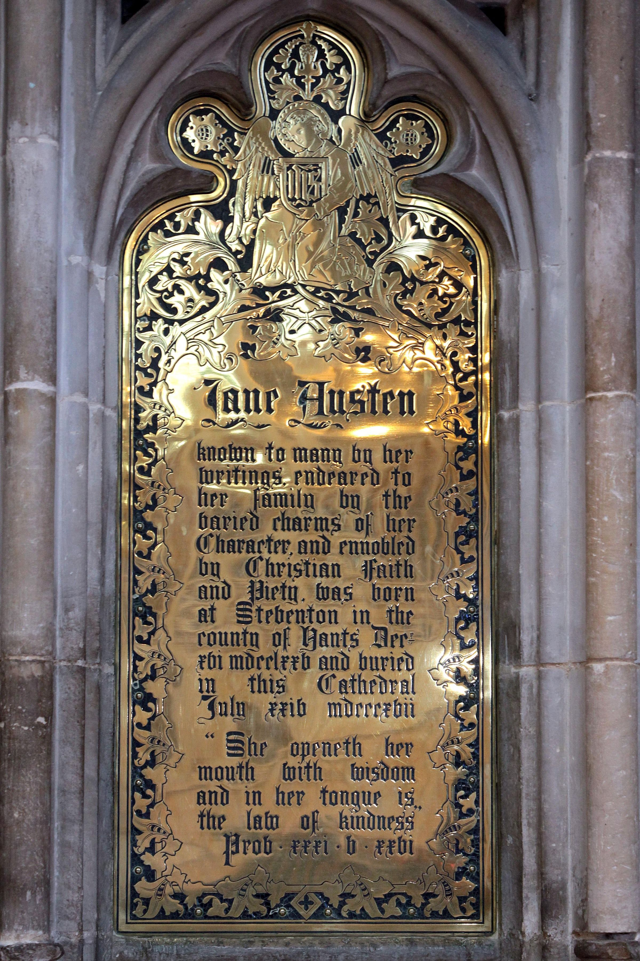
Jane Austen’s death
She died on July 18, 1817, at the age of 41. Addison’s disease.
She was buried in Winchester cathedral
First gravestone:
“The benevolence of her heart, the sweetness of her temperament the extraordinary endowments of her mind obtained the regard of all who knew her and the warmest love of her intimate connections”
Brass plaque in 1870
Jane Austen known to many by her writings, endeared to her family by the varied charms of her Character and ennobled by Christian faith and piety, […]
“She openeth her mouth in wisdom and in her tongue is the law of kindness.” Prov xxxi. v. xxvi

Slide 5
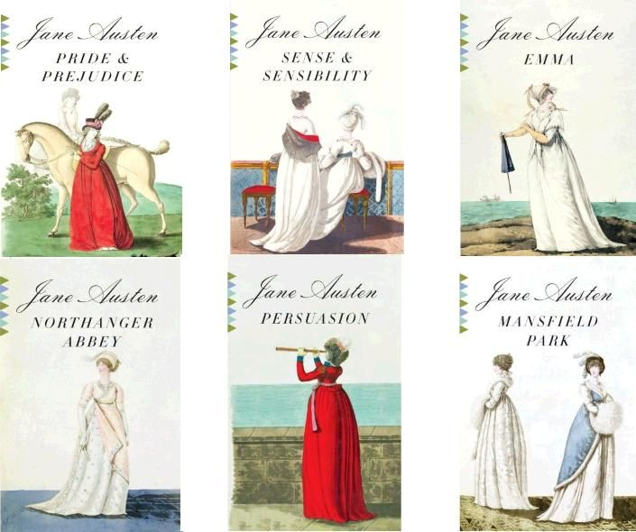
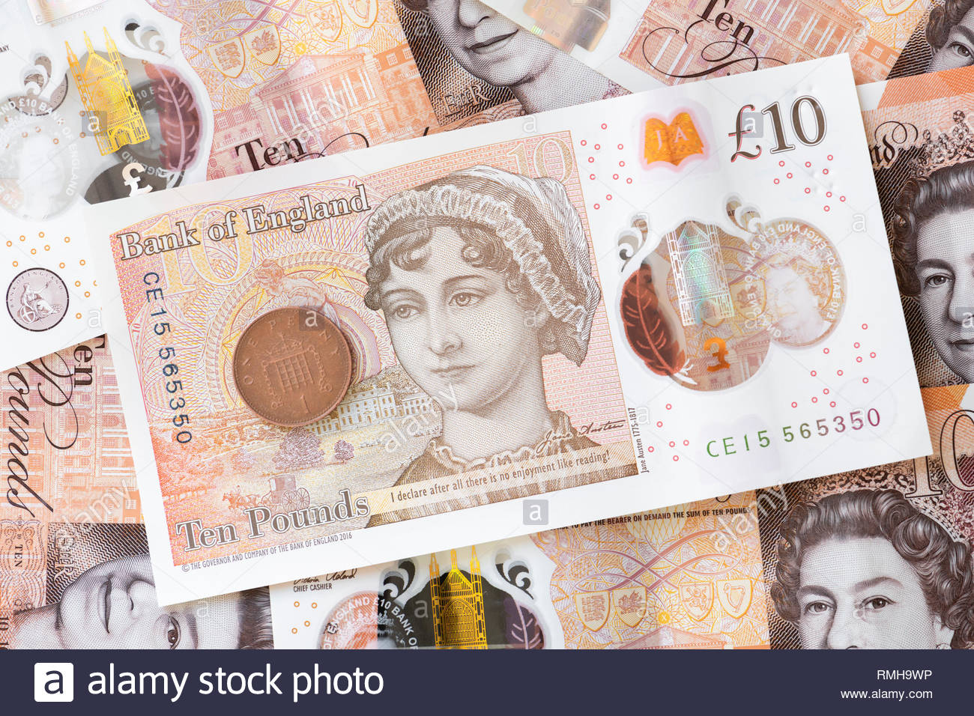
Jane Austen’s works
She wrote of the world she knew: lives of the landed gentry and clergy of rural England.
Her main works are:
Sense and Sensibility (1811),
Pride and Prejudice (1813),
Mansfield Park (1814),
Emma (1815),
Northanger Abbey (1818, posthumous),
Persuasion (1818, posthumous),
2 unfinished novels The Watsons (1803) and Sanditon (1817)
and some juvenilia (Love and Friendship (1790), Lady Susan (1794), and many more)

Slide 6
How to read a novel according to Genette
Gerard Genette, Thresholds of interpretation (Seuils, 1987), Cambridge UP, 2001
Intertextuality: a relation of co-presence between two or more texts […] the literal presence of one text within another. Quotation, the explicit summoning up of a text that is both presented and distanced by quotation marks, but also plagiarism and allusion of various kinds.
Paratextuality: those liminal devices and conventions, both within the book (peritext) and outside it (epitext), that mediate the book to the reader:
Peritext: titles and subtitles, pseudonyms, forewords, dedications, epigraphs, prefaces, intertitles, notes, epilogues, and afterwords;
Epitext: the elements in the public and private history of the book.

Slide 7
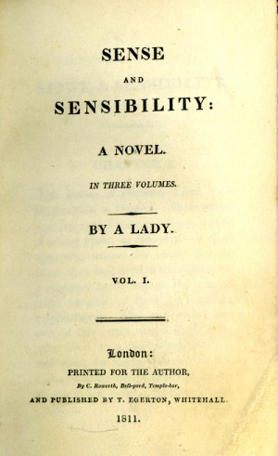
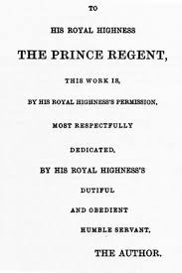
Paratext: The epitext and the peritext
1795 Jane Austen read aloud to her family what seems to have been an epistolary novel titled Elinor and Marianne
1797: Her father offered it to a publisher but he rejected it
She revised it drastically in 1797-8 (transforming it into a 3rd person narrative) and, according to Cassandra’s memoir, she titled it Sense and Sensibility.
Many letters (26), however, survive in the book and have a great role.
During the years in Bath she didn’t write but, when in Chawton, she revised it once more in 1809-10, and the novel came out at last in 1811 as Sense and Sensibility, ‘a novel in three volumes, By a Lady’, published in London by Thomas Egerton. Jane was 35.
In 1813 Egerton published also Pride and Prejudice, and the following year Mansfield Park.
In 1815 the Prince Regent declared to be an admirer of her work and Austen dedicated Emma to him.
She was named the author of her works only after her death.

Slide 8
Gerard Genette, Narrative Discourse: An Essay in Method (Discours du récit), 1972
Voice: who is the narrator?
Is it a character of the story (intra-diegetic) or is it external (extra-diegetic)?
Extra-diegetic narrator
Focalization: Who sees and how much? From what point of view?
Point of view of the character: focalized narration (partial distribution of information)
Third-person - omniscient narrator: zero or external focalization
Third person narrator in S&S but with strong focalization on Elinor’s point of view
Elinor and Marianne, epistolary novel: (multiple) focalized narration

Slide 9
From an epistolary novel to a third-person narrator
Why did she change the voice when she revised Elinor and Marianne after the rejection?
1st reason: the market trends of the publishing industry of the time. By the beginning of the new century the epistolary form in fiction was in decline (after its high point in the 1770s) .
2nd reason: the wider range of nuances that a third-person narrator offered her in the sketching of the main character, Elinor. It is hard to imagine who, among the other characters of the novel, might have served as Elinor’s correspondent. For instance, when in London, Elinor corresponds with her mother but she doesn’t confide her feelings, instead she tries to prompt her mother to try to temper Marianne’s obsessive thoughts of Willoughby.
The transition to a third person narration is largely rendered through Elinor’s focalisation (or free indirect discourse) which becomes more marked in the second volume.
For instance in chapter 23 when Elinor thinks about Lucy Steele’s revelations of her engagement to Edward Ferrars.
And chapter 40, when she elaborates on what she should write in the note she’s going to send to Edward announcing Brandon’s offer of a living.

Slide 10
Free indirect discourse
Chap. 23
However small Elinor's general dependence on Lucy's veracity might be, it was impossible for her on serious reflection to suspect it in the present case, where no temptation could be answerable to the folly of inventing a falsehood of such a description. […]
Had Edward been intentionally deceiving her? Had he feigned a regard for her which he did not feel? Was his engagement to Lucy an engagement of the heart? No; whatever it might once have been, she could not believe it such at present. His affection was all her own. She could not be deceived in that. Her mother, sisters, Fanny, all had been conscious of his regard for her at Norland; it was not an illusion of her own vanity. He certainly loved her. What a softener of the heart was this persuasion!
How much could it not tempt her to forgive! He had been blamable, highly blamable, in remaining at Norland after he first felt her influence over him to be more than it ought to be. In that, he could not be defended; but if he had injured her, how much more had he injured himself; if her case were pitiable, his was hopeless. His imprudence had made her miserable for a while; but it seemed to have deprived himself of all chance of ever being otherwise. She might in time regain tranquillity; but HE, what had he to look forward to? Could he ever be tolerably happy with Lucy Steele; could he, were his affection for herself out of the question, with his integrity, his delicacy, and well-informed mind, be satisfied with a wife like her--illiterate, artful, and selfish?

Slide 11
Direct speech - multiple focalization
Chap. 40
"Well, Miss Dashwood," said Mrs. Jennings, sagaciously smiling, as soon as the gentleman had withdrawn, "I do not ask you what the Colonel has been saying to you; for though, upon my honour, I tried to keep out of hearing, I could not help catching enough to understand his business. And I assure you I never was better pleased in my life, and I wish you joy of it with all my heart."
"Thank you, ma'am," said Elinor. "It is a matter of great joy to me; and I feel the goodness of Colonel Brandon most sensibly. There are not many men who would act as he has done. Few people who have so compassionate a heart! I never was more astonished in my life."
"Lord! my dear, you are very modest.” […]
How she should begin--how she should express herself in her note to Edward, was now all her concern. The particular circumstances between them made a difficulty of that which to any other person would have been the easiest thing in the world; but she equally feared to say too much or too little, and sat deliberating over her paper, with the pen in her hand, till broken in on by the entrance of Edward himself.
[…] He too was much distressed; and they sat down together in a most promising state of embarrassment.--Whether he had asked her pardon for his intrusion on first coming into the room, he could not recollect; but determining to be on the safe side, he made his apology in form as soon as he could say any thing, after taking a chair.

Slide 12
Chap 47 and 48 direct speech and free indirect discourse
Chap 47: The manservant Thomas
I see Mr. Ferrars myself, ma'am, this morning in Exeter, and his lady too, Miss Steele as was. They was stopping in a chaise at the door of the New London Inn, as I went there with a message from Sally at the Park to her brother, who is one of the post-boys. I happened to look up as I went by the chaise, and so I see directly it was the youngest Miss Steele; so I took off my hat, and she knew me and called to me, and inquired after you, ma'am, and the young ladies, especially Miss Marianne, and bid me I should give her compliments and Mr. Ferrars's, their best compliments and service, and how sorry they was they had not time to come on and see you, but they was in a great hurry to go forwards, for they was going further down for a little while, but howsever, when they come back, they'd make sure to come and see you.“
Chap 48
Elinor flattered herself that some one of their connections in London would write to them to announce the event, and give farther particulars,—but day after day passed off, and brought no letter, no tidings. Though uncertain that any one were to blame, she found fault with every absent friend. They were all thoughtless or indolent. […] Colonel Brandon must have some information to give. Scarcely had she so determined it, when the figure of a man on horseback drew her eyes to the window. He stopt at their gate. It was a gentleman, it was Colonel Brandon himself. Now she could hear more; and she trembled in expectation of it. But—it was NOT Colonel Brandon—neither his air—nor his height. Were it possible, she must say it must be Edward. She looked again. He had just dismounted;—she could not be mistaken,—it WAS Edward. She moved away and sat down. "He comes from Mr. Pratt's purposely to see us. I WILL be calm; I WILL be mistress of myself."

Slide 13
Multiple focalization through the letters: chapter 49
Lucy:
“Being very sure I have long lost your affections, I have thought myself at liberty to bestow my own on another, and have no doubt of being as happy with him as I once used to think I might be with you; but I scorn to accept a hand while the heart was another's. Sincerely wish you happy in your choice, and it shall not be my fault if we are not always good friends, as our near relationship now makes proper. I can safely say I owe you no ill-will, and am sure you will be too generous to do us any ill offices. Your brother has gained my affections entirely, and as we could not live without one another, we are just returned from the altar, and are now on our way to Dawlish for a few weeks, which place your dear brother has great curiosity to see, but thought I would first trouble you with these few lines, and shall always remain,
"Your sincere well-wisher, friend, and sister,
"LUCY FERRARS.
"I have burnt all your letters, and will return your picture the first opportunity. Please to destroy my scrawls--but the ring with my hair you are very welcome to keep."

Slide 14
Multiple focalization through the letters: chapter 49
Mrs Jennings
I do think," she continued, "nothing was ever carried on so sly; for it was but two days before Lucy called and sat a couple of hours with me. Not a soul suspected anything of the matter, not even Nancy, who, poor soul! came crying to me the day after, in a great fright for fear of Mrs. Ferrars, as well as not knowing how to get to Plymouth; for Lucy it seems borrowed all her money before she went off to be married, on purpose we suppose to make a show with, and poor Nancy had not seven shillings in the world;--so I was very glad to give her five guineas to take her down to Exeter, where she thinks of staying three or four weeks with Mrs. Burgess, in hopes, as I tell her, to fall in with the Doctor again. And I must say that Lucy's crossness not to take them along with them in the chaise is worse than all. Poor Mr. Edward! I cannot get him out of my head, but you must send for him to Barton, and Miss Marianne must try to comfort him.“
Mr. Dashwood
"Mrs. Ferrars has never yet mentioned Edward's name, which does not surprise us; but, to our great astonishment, not a line has been received from him on the occasion. Perhaps, however, he is kept silent by his fear of offending, and I shall, therefore, give him a hint, by a line to Oxford, that his sister and I both think a letter of proper submission from him, addressed perhaps to Fanny, and by her shewn to her mother, might not be taken amiss; for we all know the tenderness of Mrs. Ferrars's heart, and that she wishes for nothing so much as to be on good terms with her children."

Slide 15
Chap 29
Marianne:
"What am I to imagine, Willoughby, by your behaviour last night? Again I demand an explanation of it. I was prepared to meet you with the pleasure which our separation naturally produced, with the familiarity which our intimacy at Barton appeared to me to justify. I was repulsed indeed! I have passed a wretched night in endeavouring to excuse a conduct which can scarcely be called less than insulting; but though I have not yet been able to form any reasonable apology for your behaviour, I am perfectly ready to hear your justification of it. You have perhaps been misinformed, or purposely deceived, in something concerning me, which may have lowered me in your opinion. Tell me what it is, explain the grounds on which you acted, and I shall be satisfied, in being able to satisfy you. It would grieve me indeed to be obliged to think ill of you; but if I am to do it, if I am to learn that you are not what we have hitherto believed you, that your regard for us all was insincere, that your behaviour to me was intended only to deceive, let it be told as soon as possible. My feelings are at present in a state of dreadful indecision; I wish to acquit you, but certainty on either side will be ease to what I now suffer. If your sentiments are no longer what they were, you will return my notes, and the lock of my hair which is in your possession.”

Slide 16
Chap 29
"MY DEAR MADAM,
"I have just had the honour of receiving your letter, for which I beg to return my sincere acknowledgments. I am much concerned to find there was anything in my behaviour last night that did not meet your approbation; and though I am quite at a loss to discover in what point I could be so unfortunate as to offend you, I entreat your forgiveness of what I can assure you to have been perfectly unintentional. I shall never reflect on my former acquaintance with your family in Devonshire without the most grateful pleasure, and flatter myself it will not be broken by any mistake or misapprehension of my actions. My esteem for your whole family is very sincere; but if I have been so unfortunate as to give rise to a belief of more than I felt, or meant to express, I shall reproach myself for not having been more guarded in my professions of that esteem. That I should ever have meant more you will allow to be impossible, when you understand that my affections have been long engaged elsewhere, and it will not be many weeks, I believe, before this engagement is fulfilled. It is with great regret that I obey your commands in returning the letters with which I have been honoured from you, and the lock of hair, which you so obligingly bestowed on me.
"I am, dear Madam, "Your most obedient "humble servant,
"JOHN WILLOUGHBY.“
Willoughby??

Slide 17
Gerard Genette, Narrative Discourse: An Essay in Method (Discours du récit), 1972
Order
Story / Discourse: story time / narrative time
Anachrony
Analepsis or flashback
Prolepsis o flashforward

Slide 18
The plot (or discourse)
Norland Park (Chap. 1-5), death of the father, arrival of new owners, Edward’s arrival, family departure. The beginning of the main love plot: Elinor and Edward.
Barton Cottage (Chap. 6-15 ): arrival, meeting with Colonel Brandon, Marianne and Willoughby, Colonel Brandon leaves after receiving a letter, Willoughby’s sudden departure. The setting of the secondary love plot: Marianne and Willoughby.
Barton Cottage (Chap 16-25 ) Edward’s visit, after Edward’s departure, arrival of Mrs Jenning’s other daughter, Charlotte, with husband Mr Palmer and then two miss Steeles; Lucy’s revelation of her secret engagement with Edward, invitation to London. Evolution of main love plot.
London (Chap. 26-41 ) Absence of Willoughby, ball and meeting between Marianne and Willoughby, Willoughby’s letter, Brandon’s account of Willoughby’s misdeeds with Eliza Williams, arrival of the miss Steeles, dinner at Mr John Dashwood’s . Lucy meets Mrs Ferrars. Fanny invites the miss Steeles. Revelation of the secret engagement and Edward disinherited. Brandon’s offer of a rectory. Development of both main and secondary love plots.
Cleveland (Chap. 42-45): Marianne’s illness, Mr Willoughby’s visit, return of Brandon with their mother.
Barton Cottage (46-end) Marianne’s recovery, news of Mr. Ferrars’s marriage with Lucy, arrival of Edward, revelation and proposal (not described). Reconciliation with Mrs Ferrars, Edward and Elinor get married, so do Brandon and Marianne.

Slide 19
Diegetic function of letters
Chap 4: In this state of her spirits, a letter was delivered to her from the post, which contained a proposal particularly well timed. It was the offer of a small house, on very easy terms, belonging to a relation of her own, a gentleman of consequence and property in Devonshire. The letter was from this gentleman himself, and written in the true spirit of friendly accommodation.
Chap 13: Their intended excursion to Whitwell turned out very different from what Elinor had expected. She was prepared to be wet through, fatigued, and frightened; but the event was still more unfortunate, for they did not go at all. […] While they were at breakfast the letters were brought in. Among the rest there was one for Colonel Brandon;—he took it, looked at the direction, changed colour, and immediately left the room.
Chap 27, 29 & 44: Marianne and Willoughby’s letters
Chap 32 letter to Mrs Dashwood saying that Mr Dashwood will be in London
Chap 49 Lucy’s letter to Edward
Question: It has been said that Sense and Sensibility is full of secrets. Identify a few of the secrets and discuss the role they play.

Slide 20
The plot (or discourse) by volumes
Volume I: chapters 1-22: The romantic plot
Lucy’s revelation closes the first volume.
Elinor’s reflections on Edward and Lucy open the second.
Volume II: chapters 23-36 The tragic plot
The 2nd volume ends with Marianne feeling worse and worse in London and the Miss Steele’s invited by the Ferrars.
The 3rd opens with the disclosure of Edward’s secret engagement.
Volume III: chapters 37-50. The tragicomedy
Marianne nearly dies and apparently Edward gets married with Lucy
But
Marianne recovers and marries Brandon and Elinor marries Edward

Slide 21
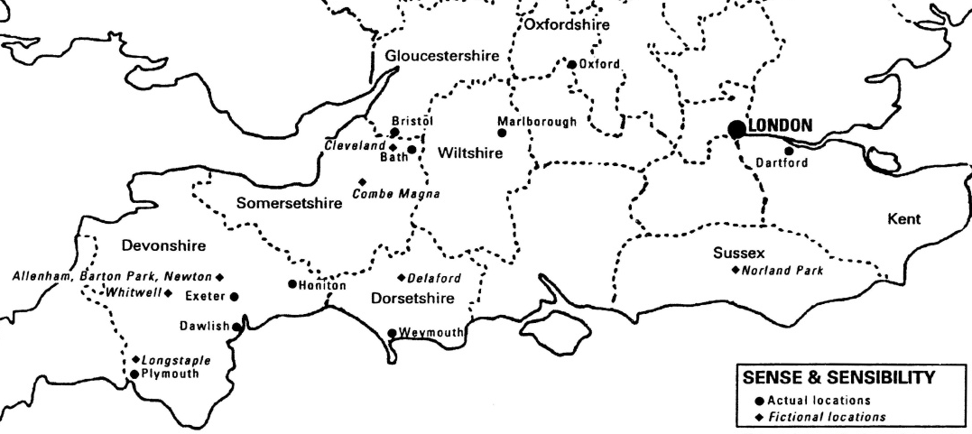
Mikhail Bakhtin “Forms of Time and of the Chronotope in the Novel”, 1975
Chronotope: interconnection of time and space in narration
Georgian England, End of 1700 (Elinor and Marianne 1795), first ten years of 1800 (S&S 1811)
Easter holidays at the end of March:
31st March 1793,
5th April 1795,
27th March 1796,
5th April 1801,
1st April 1804,
6th April 1806,
29th March 1804,
1st April1807

Slide 22
Time and action | Chapter | Place

Slide 23
Time and action | Chapter | Place
Four years before the time of narration, Edward is engaged with Lucy | Chap 22 and 49 flashback | Longstaple (near Plymouth)

Slide 24
Time and action | Chapter | Place
Four years before the time of narration, Edward is engaged with Lucy | Chap 22 and 49 flashback | Longstaple (near Plymouth)
February, Eliza Williams disappears | Chap 31 – flashback | Bath (Dorsetshire)

Slide 25
Time and action | Chapter | Place
Four years before the time of narration, Edward is engaged with Lucy | Chap 22 and 49 flashback | Longstaple (near Plymouth)
February, Eliza Williams disappears | Chap 31 – flashback | Bath (Dorsetshire)
Very early in September, arrival to Barton cottage, Devonshire | Chap 6 | Barton Park, Devonshire
“A showery October” – many balls with Willoughby | Chap 11 | Barton Park
October – planned trip to Withwell - Eliza is found A week later Willoughby leaves The next week Edward arrives at the cottage (after spending 2 weeks near Plymouth) where he stays a week | Chap 31 – flashback Chap 14 – 15 Chap 16 | Delaford Barton Park
November the Steeles arrive: “Lucy told me of her engagement” | Chap 22, 24 & 37 flashback | Barton Park
January – the Steeles arrive in town January – first week - Mrs Jennings, Elinor and Marianne also arrive Mid January – letters between Marianne & Willoughby | Chap 24 - anticipation Chap 25 Chap 32 | London

Slide 26
Time and action | Chapter | Place
February Edward & the Dashwoods arrive in town Early in February Willoughby gets married | Chap 24 - anticipation Chap 32 | London
2nd week in March - Meeting with Miss Steele | Chap 38 | London, Kensigton Gardens
End of March, the Palmers to go home, Easter holidays | Chap 39 | Cleveland in Somersetshire
Very early in April, Marianne falls ill | Chap 42 | in Cleveland
Early in the autumn, Edward and Elinor get married | Chap 50 | Barton Park
One-two years later Marianne (at 19) marries Brandon | Chap 50 | Delaford

Slide 27
The context in the text: money matters
chapter 17
cried Marianne. "What have wealth or grandeur to do with happiness?"
"Grandeur has but little," said Elinor, "but wealth has much to do with it."
"Elinor, for shame!" said Marianne, "money can only give happiness where there is nothing else to give it. Beyond a competence, it can afford no real satisfaction, as far as mere self is concerned."
"Perhaps," said Elinor, smiling, "we may come to the same point. your competence and my wealth are very much alike, I dare say; and without them, as the world goes now, we shall both agree that every kind of external comfort must be wanting. Your ideas are only more noble than mine. Come, what is your competence?"
"About eighteen hundred or two thousand a year; not more than that."
Elinor laughed. "Two thousand a year! One is my wealth! I guessed how it would end."
"And yet two thousand a-year is a very moderate income," said Marianne. "A family cannot well be maintained on a smaller. I am sure I am not extravagant in my demands. A proper establishment of servants, a carriage, perhaps two, and hunters, cannot be supported on less."

Slide 28
1000 £ in 1800s

Slide 29
The context in the text: money matters
Chap 3
Some mothers might have encouraged the intimacy from motives of interest, for Edward Ferrars was the eldest son of a man who had died very rich; and some might have repressed it from motives of prudence, for, except a trifling sum, the whole of his fortune depended on the will of his mother. But Mrs. Dashwood was alike uninfluenced by either consideration. It was enough for her that he appeared to be amiable, that he loved her daughter, and that Elinor returned the partiality. It was contrary to every doctrine of hers that difference of fortune should keep any couple asunder who were attracted by resemblance of disposition; and that Elinor's merit should not be acknowledged by every one who knew her, was to her comprehension impossible.
Chap 49
Edward had two thousand pounds, and Elinor one, which, with Delaford living, was all that they could call their own; for it was impossible that Mrs. Dashwood should advance anything; and they were neither of them quite enough in love to think that three hundred and fifty pounds a-year would supply them with the comforts of life.
Chap 50: Mrs Ferrars gives Edward 10 thousand pounds
Which would make 13000 £ of capital, that is, + the parish, a living of 1350 £ a year
And they all lived happily ever after!

Slide 30
Chapter 50 – Austen’s irony
The whole of Lucy's behaviour in the affair, and the prosperity which crowned it, therefore, may be held forth as a most encouraging instance of what an earnest, an unceasing attention to self-interest, however its progress may be apparently obstructed, will do in securing every advantage of fortune, with no other sacrifice than that of time and conscience.
Willoughby could not hear of her marriage without a pang; and his punishment was soon afterwards complete in the voluntary forgiveness of Mrs. Smith, who, by stating his marriage with a woman of character, as the source of her clemency, gave him reason for believing that had he behaved with honour towards Marianne, he might at once have been happy and rich. That his repentance of misconduct, which thus brought its own punishment, was sincere, need not be doubted;—nor that he long thought of Colonel Brandon with envy, and of Marianne with regret. But that he was for ever inconsolable, that he fled from society, or contracted an habitual gloom of temper, or died of a broken heart, must not be depended on—for he did neither. He lived to exert, and frequently to enjoy himself. His wife was not always out of humour, nor his home always uncomfortable; and in his breed of horses and dogs, and in sporting of every kind, he found no inconsiderable degree of domestic felicity.
Question: How did you feel about Willoughby when he first entered the novel? Is his apology to Elinor at the end of the book believable? Should Elinor have told her sister what he said?

Slide 31
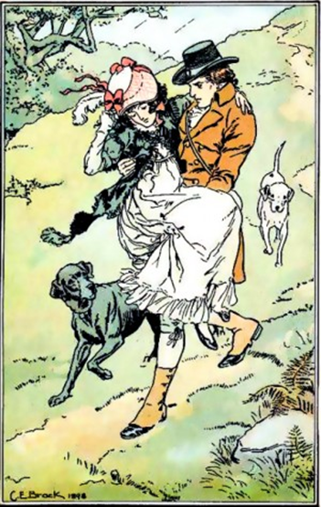
Austen and Romanticism
Intertextuality: References to Cowper, Scott, Thomson, Pope and Shakespeare (Hamlet)
Question: Consider the significance of the novel’s title. How are the qualities of sense and sensibility represented in the main characters?
Chapter 10: “You know what he thinks of Cowper and Scott; you are certain of his estimating their beauties as he ought, and you have received every assurance of his admiring Pope no more than is proper. […] Another meeting will suffice to explain his sentiments on picturesque beauty, and second marriages, and then you can have nothing farther to ask."
Chapter 11: "Your sister, I understand, does not approve of second attachments."
"No," replied Elinor, "her opinions are all romantic."
Chapter 18: “admiration of landscape scenery is become a mere jargon. Every body pretends to feel and tries to describe with the taste and elegance of him who first defined what picturesque beauty was.”

Slide 32
The danger of romantic love for women – the 2 Eliza
Chap 11 Eliza
"I cannot agree with you there," said Elinor. "There are inconveniences attending such feelings as Marianne's, which all the charms of enthusiasm and ignorance of the world cannot atone for. Her systems have all the unfortunate tendency of setting propriety at nought; and a better acquaintance with the world is what I look forward to as her greatest possible advantage."
[…] "This," said he, "cannot hold; but a change, a total change of sentiments—No, no, do not desire it; for when the romantic refinements of a young mind are obliged to give way, how frequently are they succeeded by such opinions as are but too common, and too dangerous! I speak from experience. I once knew a lady who in temper and mind greatly resembled your sister, who thought and judged like her, but who from an inforced change—from a series of unfortunate circumstances"—
Chap 13 and 31 Miss Williams

Slide 33
Character construction
Dynamic: changes over time, usually as a result of resolving a central conflict or facing a major crisis. Most dynamic characters tend to be central rather than peripheral characters, because resolving the conflict is the major role of central characters.
Static: does not change over time; his or her personality does not transform or evolve.
Question: Is Elinor a static or dynamic character?
Question: Is Edward a static or dynamic character? How are his actions toward Elinor similar to those of Willoughby toward Marianne?
Question: Can you think of (other) static characters in the novel?
Question: How and why does Marianne become ill?

Slide 34
Marianne’s Illness – a psychosomatic disease?
Chapter 42
Marianne's feeling, in her head and throat, the beginning of a heavy cold, […] Two delighted twilight walks on the third and fourth evenings of her being there, not merely on the dry gravel of the shrubbery, but all over the grounds, and especially in the most distant parts of them, where there was something more of wildness than in the rest, where the trees were the oldest, and the grass was the longest and wettest, had- assisted by the still greater imprudence of sitting in her wet shoes and stockings- given Marianne a cold so violent as, though for a day or two trifled with or denied, would force itself by increasing ailments on the concern of every body, and the notice of herself. Prescriptions poured in from all quarters, and as usual, were all declined. Though heavy and feverish, with a pain in her limbs, and a cough, and a sore throat, a good night's rest was to cure her entirely; and it was with difficulty that Elinor prevailed on her, when she went to bed, to try one or two of the simplest of the remedies.
Chapter 46
My illness, I well knew, had been entirely brought on by myself by such negligence of my own health, as I had felt even at the time to be wrong. Had I died,—it would have been self-destruction.
Question: In the end, does Marianne grow as a character to become self-aware?

Slide 35
The taming of Marianne
Chapter 50
Marianne Dashwood was born to an extraordinary fate. She was born to discover the falsehood of her own opinions, and to counteract, by her conduct, her most favourite maxims. She was born to overcome an affection formed so late in life as at seventeen, and with no sentiment superior to strong esteem and lively friendship, voluntarily to give her hand to another!—and THAT other, a man who had suffered no less than herself under the event of a former attachment, whom, two years before, she had considered too old to be married,—and who still sought the constitutional safeguard of a flannel waistcoat!
But so it was. Instead of falling a sacrifice to an irresistible passion, as once she had fondly flattered herself with expecting,—instead of remaining even for ever with her mother, and finding her only pleasures in retirement and study, as afterwards in her more calm and sober judgment she had determined on,—she found herself at nineteen, submitting to new attachments, entering on new duties, placed in a new home, a wife, the mistress of a family, and the patroness of a village.
But
They each felt his sorrows, and their own obligations, and Marianne, by general consent, was to be the reward of all. […]
With such a confederacy against her—with a knowledge so intimate of his goodness—with a conviction of his fond attachment to herself, which at last, though long after it was observable to everybody else—burst on her—what could she do?

Slide 36
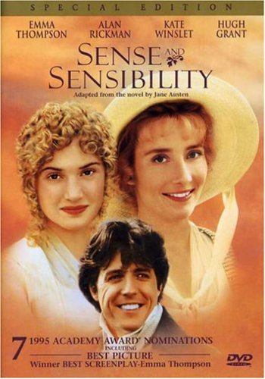
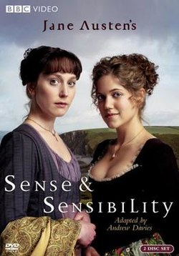
Sense and Sensibility - 1995
Director: Ang Lee
Screenplay.: Emma Thompson
Cast: Hugh Grant, Alan Rickman, Emma Thompson, Kate Winslet
Distr.: Columbia, Tristar Studios
Sense and Sensibility - 2008
Director: John Alexander
Screenplay.: Andrew Davies
Cast: Hattie Morahan, Charity Wakefield
Distr.: BBC

Slide 37
Modernization: change of chronotope but same elements
Final question: In the end, does sense triumph over sensibility? Or is Austen sympathetic to both perspectives?
trailer
India 8:32 to 9:50

Slide 38
Questions list (for those who still have to finish the book….)
It has been said that Sense and Sensibility is full of secrets. Identify a few of the secrets and discuss the role they play.
How did you feel about Willoughby when he first entered the novel? Is his apology to Elinor at the end of the book believable? Should Elinor have told her sister what he said?
Consider the significance of the novel’s title. How are the qualities of sense and sensibility represented in the main characters?
Is Elinor a static or dynamic character?
Is Edward a static or dynamic character? How are his actions toward Elinor similar to those of Willoughby toward Marianne?
Can you think of (other) static characters in the novel?
How and why does Marianne become ill?
In the end, does Marianne grow as a character to become self-aware?
In the end, does sense triumph over sensibility? Or is Austen sympathetic to both perspectives?

Slide 39
Further readings:
R.Grandi, “Silenzio e Sentimento. Parole, immagini e censura nel romanzo di Jane Austen e in tre adattamenti” in F. Marroni e F. D’Alfonso, eds., Jane Austen. Silenzi, lacune, allusioni, Carabba, Lanciano, ISBN 978-88-6344-547-3, 2018, pp. 135-156
R. Grandi, Il Corpo di Jane Austen. Incarnazioni letterarie e filmiche tra desiderio e repressione, Firenze: EditPress, ISBN: 978-88-9782-667-5, 2017, pp. 252
R. Grandi, “World Austen: empowerment and tradition on the screen”, Textus, ISSN: 1824-3967, vol. 3 n. 3, 2017, pp. 129-145
R. Grandi, “Screening Jane. When History, Biography and Fiction create a Cinematic Life”, Lingue e Linguaggi, ISSN: 2239-0367 e 2239-0359, vol. 13, 2015, pp. 301-309.

